Slide 1
Manage External Sharing
Speaker Name

Slide 3
Objectives
After completing this section, you will:
Understand external sharing and external user access
Know the different types of external users
Understand the settings available for governing external user access

Slide 4
External Users

Slide 5
External Sharing feature
The External sharing capability in SharePoint Online provides the ability for users to share and collaborate on documents and content stored in SharePoint Online with vendors, partners, and customers, who are not within your organization (tenant).
The External sharing feature in SharePoint Online is the recommended alternative to sharing documents externally via email because it provides more control and governance to the items being shared.
SharePoint Online has both global (tenant-wide) and site collection settings for external sharing.
External sharing is turned on by default for your entire SharePoint environment and the sites in it. You may want to turn it off globally before people start using sites or until you know exactly how you want to use the feature.
Notes:
If you're working with vendors, clients, or customers outside of your organization, you might want to give them access to certain areas of your site or to specific documents. In this article, we'll show you how to turn sharing on or off sharing for SharePoint Online. You must be a global or SharePoint admin in Microsoft 365 to do this.
External sharing is controlled at both the organization level (global settings that affect all of SharePoint Online) and the site collection level. The organization-level settings determine what options are available at the site collection level.
The external sharing settings for individual site collections cannot be less restrictive than whatever is allowed at the organization level, but these settings can be more restrictive. For example, if external sharing is turned on at the organization level, but it is limited to allowing only authenticated users, then that will be the only kind of external sharing you can allow in a specific site collection. If external sharing through both sign-in and anonymous guest links is allowed at the organization level, then those options are also available for each site collection.

Slide 6
External Users
An external user is someone from outside your Microsoft 365 subscription to whom you have given access to one or more sites, files, or folders.
External users are also referred to as “Guest” accounts in Azure Active Directory
There are three types of external users:
Authenticated external users with Microsoft accounts
Authenticated external users without Microsoft accounts
Anonymous users

Slide 7
Authenticated external users with Microsoft accounts
This type of external user signs in using their own Microsoft account, or a work or school account from another Microsoft 365 tenant
Can share sites, files, and folders
They can perform tasks on a site consistent with the permission level that they are assigned
They can use Office Online for viewing and editing documents
They will be able to see any types of content on sites, depending on the permissions given to them.
Accounts get added as guests in Azure AD of target tenant with #EXT# in their username.
Notes:
Sharing invite sent to “Specific people” who have a Microsoft Account or a work or school account in another Microsoft 365 tenant
This type of external user signs in using their own Microsoft account, or a work or school account in another Microsoft 365 tenant
You can share sites, files, and folders with this type of external user
They can perform tasks on a site consistent with the permission level that they are assigned
If you add an external user to the Members group, they will have Edit permissions and they will be able to add, edit and delete lists and share
They can use Office Online for viewing and editing documents.
If your plan includes Office Professional Plus, they cannot install the desktop version of Office on their own computers unless you assign them a license.
They will be able to see other types of content on sites, depending on the permissions you give them.
For example, they can navigate to different subsites within the site collection to which they were invited.
Accounts get added as Guest accounts in Azure AD of target tenant with #EXT# in their user name
Sharing sites with authenticated external users
When you share a site with an authenticated external user, an invitation is sent to them via email which contains a link to the site or document. When they click the link, they are asked to log in using the username and password of their Microsoft account or their work or school account. When they log in, they are added to the users list in your Microsoft 365 subscription (you'll see them listed with #EXT# in their user name) and given access to the site or document.
Once they are in the user list in your Microsoft 365 subscription, you can grant them access to other sites or documents without sending them additional invitations. (You may need to send them a link to the site or document so they can find it.) You can also assign them an Microsoft 365 license if you want.
You can discontinue sharing with an authenticated external user by removing their permissions from the site, or by removing them from the user list in Microsoft 365.

Slide 8
External users without Microsoft accounts
The email one-time passcode (OTP) feature is a way to authenticate external users when they can't be authenticated through other means, such as Azure AD, Microsoft account (MSA), or social identity providers.
When this type of external user tries to redeem an invitation or sign into a shared resources, they can request a temporary OTP, which is sent to their email address. Then they enter this passcode to continue signing in
You can share files and folders with specific people that have email address.
You cannot share sites with users unless they have a Microsoft account or a work or school account in another Microsoft 365 tenant
Starting October 2021, the email one-time passcode feature will be turned on for all existing tenants and enabled by default for new tenants. If you don't want to allow this feature to turn on automatically, you can disable it. See Disable email one-time passcode
Notes:
Sharing files and folders with authenticated external users
When you share a file or folder with an external user who has their own Microsoft 365 email address (a work or school account), an email is sent to them which contains a link to the file or folder. The first time they access the file or folder using the link, they are sent a time-sensitive code via email that they can use to verify their identity. They must enter the code to access the file or folder. Once they have accessed the file or folder for the first time, these external users are added as guests to your Microsoft 365 directory and thereafter they can access the file using thier work or school account.
When you share a file or folder with an authenticated external user who does not have a work or school account, an email is sent to them which contains a link to the file or folder. Each time they access the file or folder using the link, they are sent a time-sensitive code via email that they can use to verify their identity. They must enter the code to access the file or folder.
These external users are not added to your Microsoft 365 directory.
There is a change scheduled for release in Q1CY19 in which OTP external users will get added as a Guest account in AzureAD of the target tenant with #EXT# in their username

Slide 9
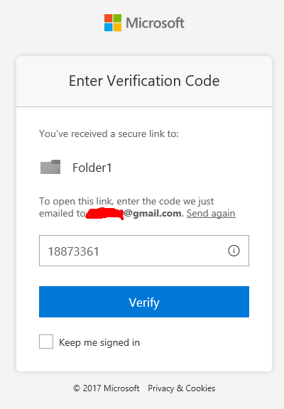
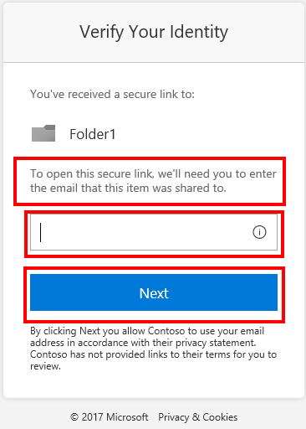
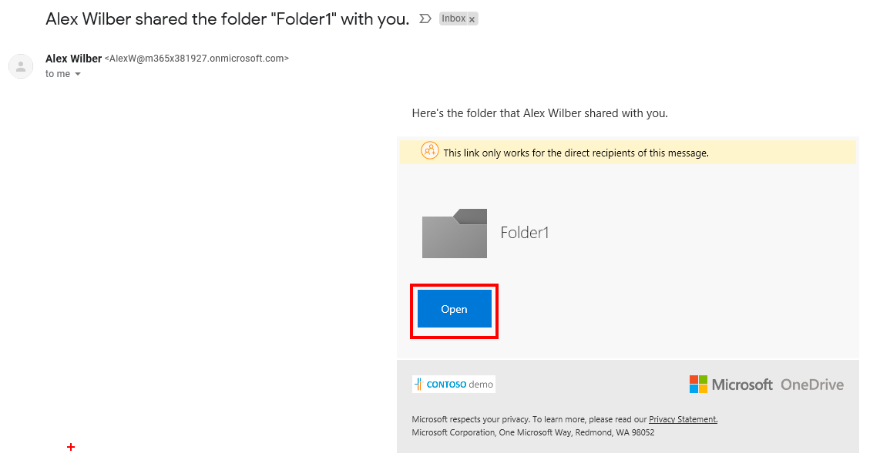
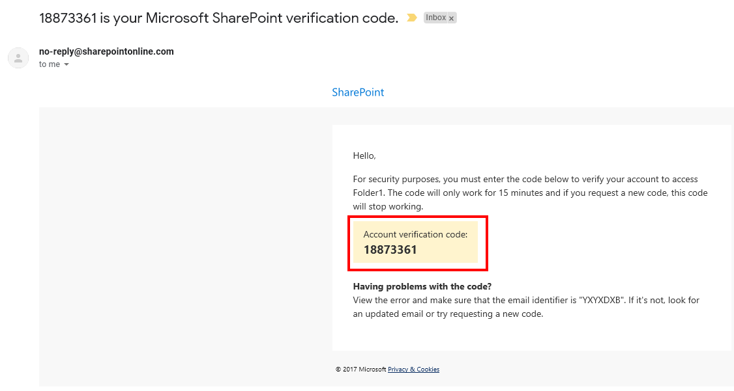
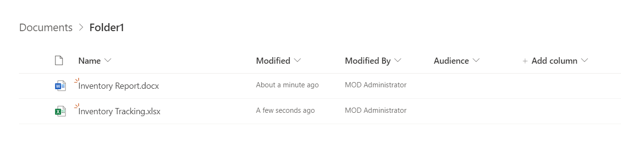
One Time Passcode sign-in experience
External User receives email that contains link to the shared file or folder
User must validate their email address that the invite was sent to
User recieves a onetime pass code in a seperate email
User enters the OTP
User gains access to the file or folder that is shared with them
Notes:
User experience for one-time passcode guest users
When the email one-time passcode feature is enabled, newly invited users who meet certain conditions will use one-time passcode authentication. Guest users who redeemed an invitation before email one-time passcode was enabled will continue to use their same authentication method.
With one-time passcode authentication, the guest user can redeem your invitation by clicking a direct link or by using the invitation email. In either case, a message in the browser indicates that a code will be sent to the guest user's email address. The guest user selects Send code: A passcode is sent to the user’s email address. The user retrieves the passcode from the email and enters it in the browser window: The guest user is now authenticated, and they can see the shared resource or continue signing in.

Slide 10
One-time passcodes
One-time passcodes are valid for 30 minutes.
After 30 minutes, that specific one-time passcode is no longer valid, and the user must request a new one.
User sessions expire after 24 hours. After that time, the guest user receives a new passcode when they access the resource.
Session expiration provides added security, especially when a guest user leaves their company or no longer needs access.
Notes:
User experience for one-time passcode guest users
When the email one-time passcode feature is enabled, newly invited users who meet certain conditions will use one-time passcode authentication. Guest users who redeemed an invitation before email one-time passcode was enabled will continue to use their same authentication method.
With one-time passcode authentication, the guest user can redeem your invitation by clicking a direct link or by using the invitation email. In either case, a message in the browser indicates that a code will be sent to the guest user's email address. The guest user selects Send code: A passcode is sent to the user’s email address. The user retrieves the passcode from the email and enters it in the browser window: The guest user is now authenticated, and they can see the shared resource or continue signing in.

Slide 11
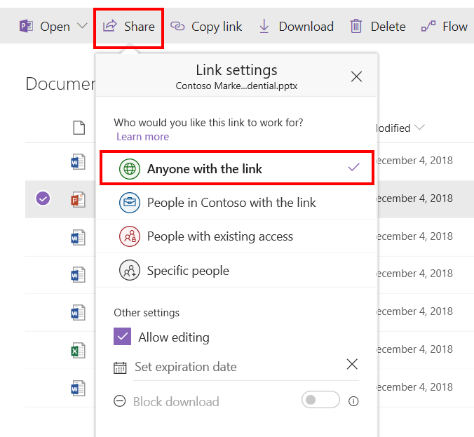
Anonymous Users
Sharing invite sent to “Anyone with the link” rather then specific people
Users who have a shareable link to a folder or document
Users can view or edit the document using Office Online, or upload to the folder (depending on the type of link) without having to sign in with a username/password, or one-time passcode.
Can be used as an alternative to sharing unsecured attachments in email
Anonymous links can be freely passed around between users and are valid until you disable them, or they expire (if you've set an expiration date).
Notes:
Note! The Anyone with the link option appears only when the Sharing setting is set to Anyone in the SPO Admin center
Sharing with anonymous users
When you share with anonymous users, you can allow them to edit or to view a document or upload to a folder. View and edit links are created separately and can be set to expire at a specified time. Once you have created these links, they can be reused and passed around freely. Anyone with the link can access the document.
Anonymous users are not added to the user list in Microsoft 365. You can discontinue sharing with them by going to the document or folder that you shared and deleting the anonymous link.

Slide 12
Configuring SharePoint Online External Sharing

Slide 13
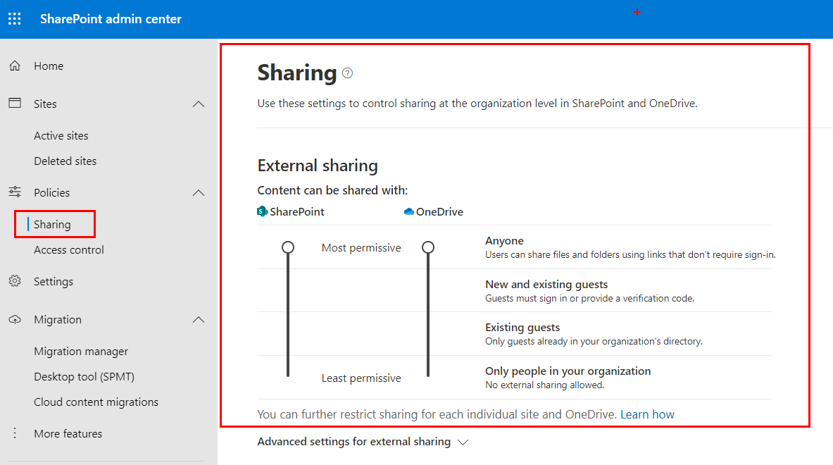
Turn External Sharing On/Off at SharePoint tenant level
External sharing is turned on by default for the entire SharePoint Online environment (tenant) and the default site collections in it
It is not enabled by default on newly created classic site collections
It is enabled by default on all newly created Modern team site collections
It is not enabled by default on newly created Communication site collections
Can be turned off globally at SPO tenant level before people start using sites or until you know exactly how you want to use the feature.
NOTE: Your sharing settings for OneDrive for Business cannot be more permissive than settings for SharePoint.
Notes:
External sharing is turned on by default for your entire SharePoint Online environment (sometimes referred to as a tenant) and the site collections in it. You may want to turn it off globally before people start using sites or until you know exactly how you want to use the feature.
You have a lot of flexibility when enabling external sharing so you’ll want to spend some time considering your options. For example, you can enable sharing across the tenant, which gives all users the ability to share. You can limit sharing to certain site collections so only those site collection administrators and administrators of sites within those collections can invite external users. You can also limit the ability to share sites and documents to a select group of users.
Turn External Sharing On or Off for a SharePoint Online Environment (Tenant)
You can configure external sharing at two levels within the SharePoint admin center:
You can turn external sharing on or off globally for an entire SharePoint Online environment (or tenant). Additionally, if you turn on external sharing, you can specify if you want to allow sharing only with authenticated users, or if you want to allow users to share content with both authenticated users and anonymous users through guest links.
When you first sign in to the SharePoint admin center, external sharing is turned on by default for both, your entire SharePoint Online environment (sometimes referred as a tenant) and the site collections in it. You might want to turn it off globally before people start using sites or until you know exactly how you want to use the feature.
You should include planning for external sharing as a part of your overall permissions planning for SharePoint Online. In general, it is a best practice to operate on the principle of least privilege and grant external users minimal and limited access to your environment. You might even want to create a special permissions group to which external users are assigned when they receive invitations. You should also consider segmenting your content by security levels, so that sensitive content is centrally located and can be tightly secured. If you anticipate an ongoing need to have external users sign in to your site and perform specific tasks, consider creating a site collection that is dedicated to the purpose of external sharing. This way, you can allow external users access to specific content without opening up your entire environment to them.

Slide 14
External Sharing Options explained
Don't allow sharing outside your organization
Users will not be able to share sites or content with external users, even if those users are already in your directory.
Allow sharing only with the external users that already exist in your organization's directory
In your Azure AD because they previously accepted sharing invitations or because they were manually imported, such as through Azure B2B collaboration
You can tell an external user because they have #EXT# in their username.
Allow users to invite and share with authenticated external users
Require external users who have received invitations to view sites or content to sign-in with a Microsoft account before they can access the content.
Site owners and members can share sites with external users.
Site owners and members on a site can share documents with external users.
All external users will be required to sign in before they can view content.
Allow sharing to authenticated external users and using anonymous access
Allow site users to share sites with people who sign in as authenticated users, but you also want to allow site users to share documents using anonymous guest links, which do not require invited recipients to sign in.
Optionally, you can set anonymous access links to expire in a specific number of days, and select how recipients can use the links
This is recommended over sharing documents via email attachments that cannot be controlled
Notes:
Don't allow sharing outside your organization Prevent all users on all sites from sharing sites or sharing content on sites with external users. Users will not be able to share sites or content with external users, even if those users are already in your directory. Allow sharing only with the external users that already exist in your organization's directory Allow sharing only for external users who are already in your directory. These users may exist in your directory because they previously accepted sharing invitations or because they were manually imported, such as through Azure B2B collaboration. (You can tell an external user because they have #EXT# in their username.) Allow users to invite and share with authenticated external users Require external users who have received invitations to view sites or content to sign-in with a Microsoft account before they can access the content. Site owners and members can share sites with external users. Site owners and members on a site can share documents with external users. All external users will be required to sign in before they can view content. Invitations to view content can be redeemed only once. After an invitation has been accepted, it cannot be shared or used by others to gain access. Allow sharing to authenticated external users and using anonymous access (Optionally, you can set links to expire in a specific number of days and select how recipients can use the links .) Allow site users to share sites with people who sign in as authenticated users, but you also want to allow site users to share documents through the use of anonymous guest links, which do not require invited recipients to sign in. Site owners or others with full control permissions can share sites with external users. All external users will be required to sign in before they can view content on a site that has been shared. When sharing documents, site owners' members can opt to require sign-in or send an anonymous guest link. When users share a document, they can grant external users either view or edit permissions to the document. External users who receive anonymous guest links can view or edit that content without signing in. Anonymous guest links could potentially be forwarded or shared with other people, who might also be able to view or edit the content without signing in.
Note
If you turn off external sharing for your entire environment and later turn it back on, external users who previously had access to content or documents on sites will regain access to them. If you know that external sharing was previously turned on and in use for specific site collections and you do not want external users to be able to regain access if external sharing is ever turned on again globally, we recommend that you first turn off external sharing for those specific site collections. If you disable external access, or limit external access to a more restrictive form, external users will typically lose access within one hour of the change. If you disable external access, access to resources will also be blocked to guest members of Microsoft 365 Groups.

Slide 15
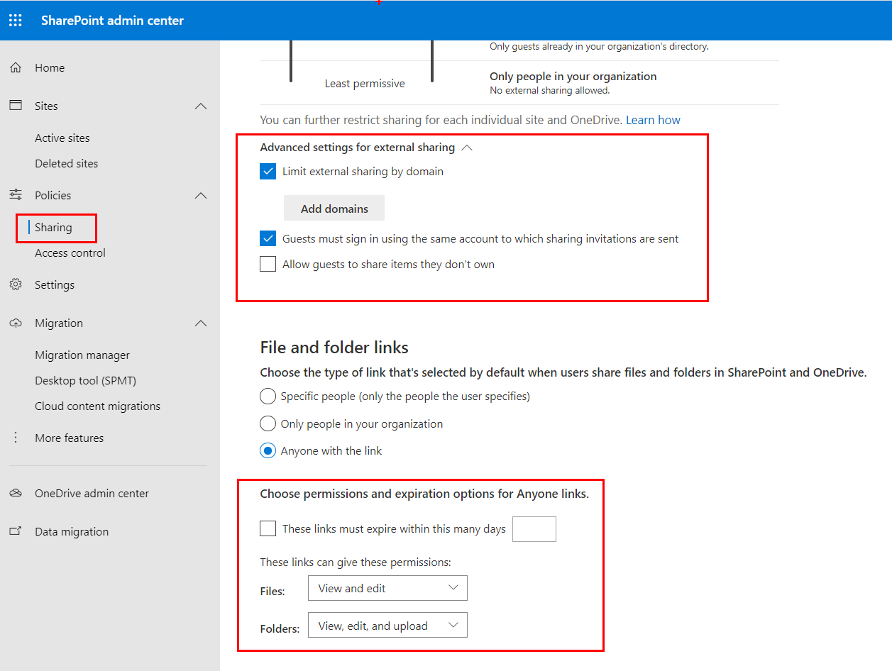
Sharing – Additional admin settings
Define groups of users that can share with external users.
Set a domain Allowed or Blocked list;
Can add a maximum of 1000 domains in the box provided, using the format domain.com
The domain allow or block list is applicable to all site collections including OneDrive for Business
Set whether external user must accept sharing invitations using the same account that the invitations were sent to
Notes:
Additional settings
Specify who can share outside your organization
You can manage who can send sharing invitations to external users by limiting such sharing to members of a specified security group. Select Let only users in selected security groups share with authenticated external users or Let only users in selected security groups share with authenticated external users and using anonymous links and specify the security group that you want to use.
Set a default link type and default permissions
To better manage the type of links users share, you can set the default type of link - and the permissions for that link - that shows when users select Get a link to share documents and folders.
The most permissive types of links, of course, are Anonymous Access links (Anyone links) which grant access to anyone who has the link. Internal links can be used only by users within your organization, and Direct links are accessible only by users who already have permission to access the document or folder. For more information, see Change the default link type when users get links for sharing.
Note that these options provide a default setting for the sites in your organization, but site owners can choose different default link types and permissions for each site if they choose to.
Additional settings
When you choose to allow users to share outside your organization, you have some additional ways to allow or limit sharing.
Limit external sharing using domains: You can allow or restrict access to specific domains. For more information, see Restricted Domains Sharing in Microsoft 365 SharePoint Online and OneDrive for Business.
Prevent external users from sharing files, folders, and sites they don't own: External users cannot share anything they don't own with anyone else.
External users must accept sharing invitations using the same account that the invitations were sent to: External users cannot use a different account than the one that the sharing invitation was sent to get access.
Notifications
To help your OneDrive for Business users monitor and control which external users have access to their files, you can specify that owners of OneDrive for Business files and folders are emailed when:
Another user invites external users to shared files
An anonymous access link is created or changed.
Note
The External users accept invitations to access files notification no longer works for the new sharing experience that appears in most places. This setting will be removed.

Slide 16

Turn External Sharing On/Off for the SharePoint PowerShell
Set-SPOTenant –SharingCapability {value}
The valid values are:
ExternalUserAndGuestSharing (default setting) - External user sharing (share by email) and anonymous guest link sharing are both enabled.
ExternalUserSharingOnly - External user sharing (share by email) is enabled, but guest link sharing is disabled.
Disabled - External user sharing (share by email) and guest link sharing are both disabled.

Slide 17

Set SPO tenant level domain Allowed or Blocked list using PowerShell
Set-SPOTenant –{option}
SharingDomainRestrictionMode
Valid values are: None, AllowList, or BlockList
SharingBlockedDomainList
Specifies a list of email domains that is blocked or prohibited for sharing with the external collaborators.
SharingAllowedDomainList
Specifies a list of email domains that is allowed for sharing with the external collaborators.
Maximum of 1000 domains allowed in a list
Notes:
Set-SPOTenant
-SharingDomainRestrictionMode
Valid values are: None, AllowList, or BlockList
-SharingBlockedDomainList
Specifies a list of email domains that is blocked or prohibited for sharing with the external collaborators. Use space character as the delimiter for entering multiple values. For example, “contoso.com fabrikam.com”.
-SharingAllowedDomainList
Specifies a list of email domains that is allowed for sharing with the external collaborators. Use the space character as the delimiter for entering multiple values. For example, “contoso.com fabrikam.com”.
Maximum of 1000 domains allowed in a list

Slide 18
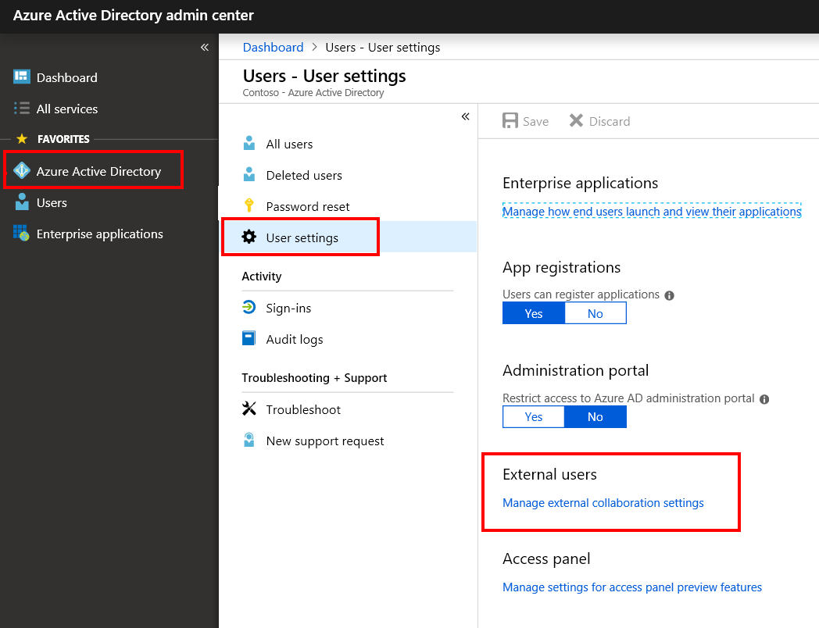
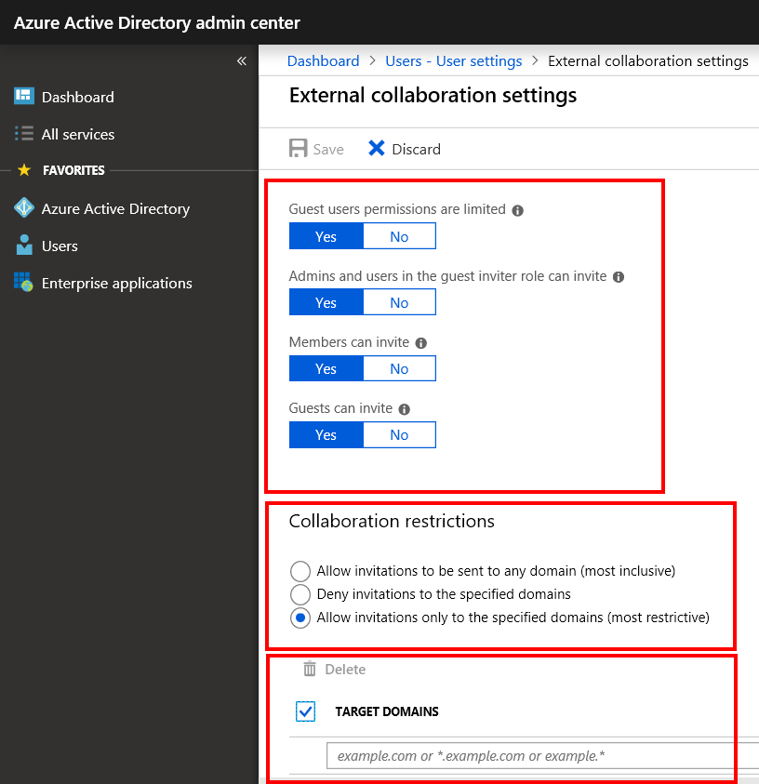
Configure external collaboration settings
The External collaboration settings in Azure Active Directory control the external sharing capabilties for Microsoft 365 Groups
These settings in Azure AD do not control or reflect the external sharing settings for site collections, folders, or files in SharePoint Online
These settings in Azure AD need to be configured in addition to the external sharing settings in SharePoint Online.

Slide 19
Set Site Collection level domain Allowed or Blocked list using PowerShell
Use Set-SPOsite to configure a domain Allowed or Blocked list for a specific site collection:
-SharingAllowedDomainList <String>
-SharingBlockedDomainList <String>
Set-SPOSite -Identity https://contoso.sharepoint.com/sites/site1 -SharingAllowedDomainList <String>
Use the space character as the delimiter for entering multiple values. For example, “contoso.com fabrikam.com”
Site collection level setting cannot be less restrictive than the tenant level setting
Ex. You cannot add a domain to the domain Allowed list at a site collection level if the same domain is blocked at the tenant level

Slide 20
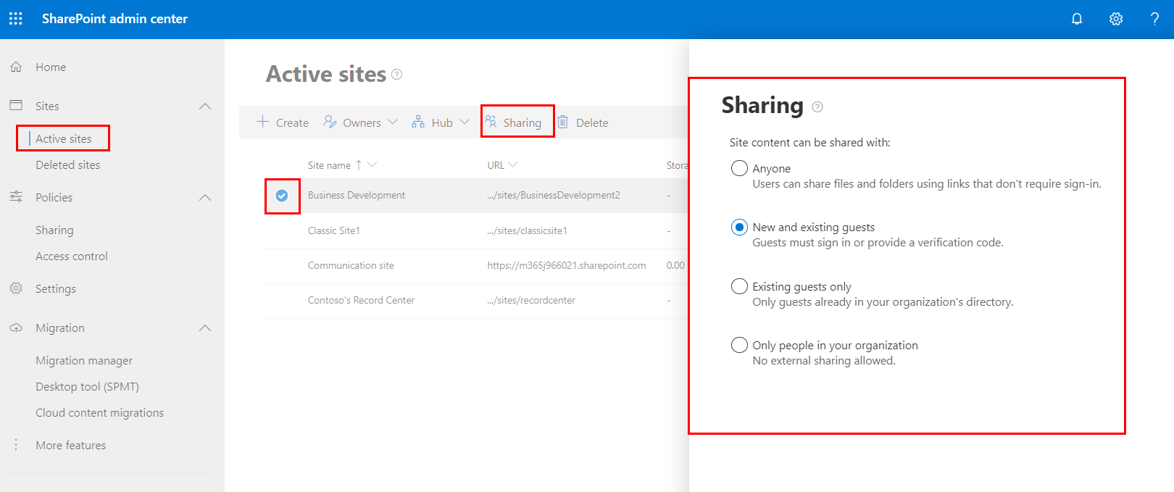
Settings for External Sharing On/Off for the Site Collection
Notes:
NOTE: The external sharing options available at the site collection level are determined by the level of external sharing that is enabled at the tenant level.
For example, if Anonymous guest access is not enabled at the tenant level, the Anyone option at the site collection level will be greyed out and unavailable.

Slide 21
Use Site script to disable external sharing on all newly created Modern site collections
{
"$schema": "schema.json",
"actions": [
{
"verb": "setSiteExternalSharingCapability",
"capability": "Disabled"
}
],
"version": 1
}
$sitescript = Get-Content C:\scripts\DisableExtSharingSiteScript.json -Raw
Add-SPOSiteScript -Title "ExternalSharingDisabled" -Content $sitescript -Description "This sitescript disables external sharing when creating new modern sites" -Verbose
Add-SPOSiteDesign -IsDefault -Title "TeamSitesExtSharingDisabled" -WebTemplate 64 -SiteScripts 127087db-993c-4c86-80f3-84598b8fa8f9 -Description "Disables external sharing for modern teamsites"

Slide 22
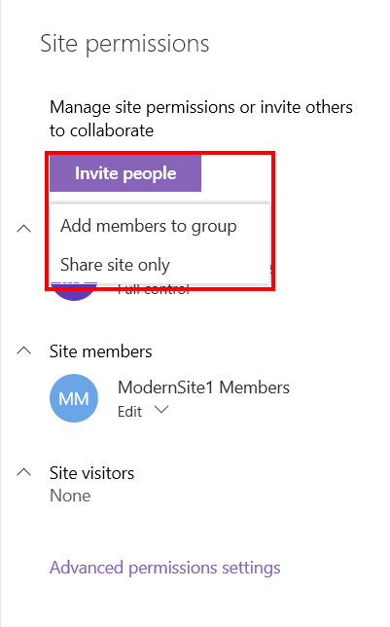
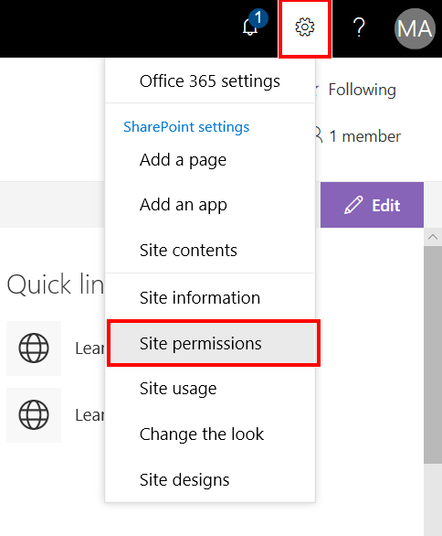
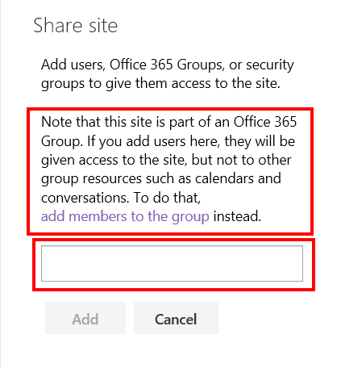
Sharing a modern Site Collection connected to O365 Group

Slide 23
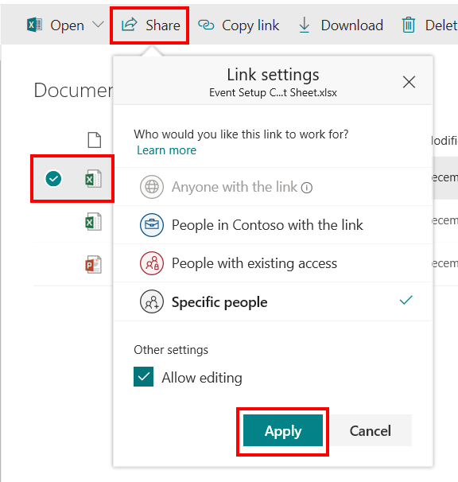
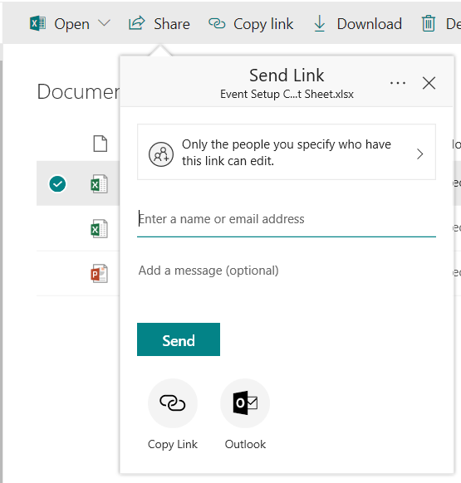
Sharing a Document
Notes:
NOTE: The “Anyone with the link” option is only available when the “Anonymous access links” option for external sharing is enabled at the tenant and site collection level

Slide 24
Site Sharing Settings
Or how to handle Access requests
Use this tenant level setting to block external user’s ability to reshare sites, files and folders they’ve been granted access to:
Set-SPOTenant -PreventExternalUsersFromResharing $true
Admin can select the Sharing permissions

Slide 25
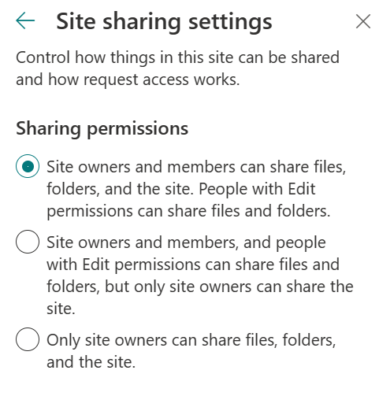
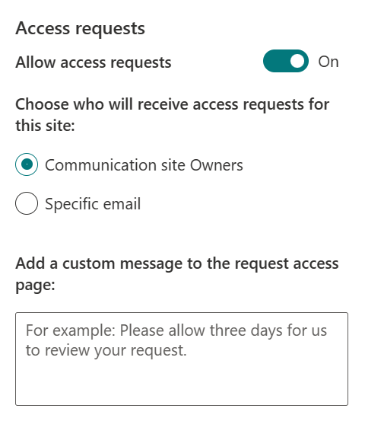
Site Sharing Settings
Site owner can decide what options for Site Sharing users have.
They can also decide how Access Requests would be handled.
SharePoint Admin can block external user’s ability to reshare sites, files and folders they’ve been granted access to on the tenant level with PS:
Set-SPOTenant -PreventExternalUsersFromResharing $true

Slide 26
Azure AD External Identities - B2B

Slide 27
Guest user access with Azure AD B2B
Azure Active Directory (Azure AD) business-to-business (B2B) collaboration is a feature included in the Azure AD External Identities feature set that lets you add and invite guest users to collaborate with your organization.
Securely share your company's applications and services with guest users from any other organization, while maintaining control over your own corporate data.
There’s no external administrative overhead for your organization. Guest users sign into your apps and services with their own work, school, or social identities.
Provides ability to add guest accounts directly to Azure AD
You don't need to manage external accounts or passwords.
You don't need to sync accounts or manage account lifecycles.
Azure AD External Identities (B2B) feature does require Azure AD P1 or P2 licensing
The first 50,000 Monthly Active External Users per month are free for both Premium P1 and Premium P2 features.
You can use authorization policies for specific guest users to protect your corporate content.
Conditional Access policies, such as multi-factor authentication, can be enforced at the tenant and application levels
Notes:
Azure AD External Identities pricing is based on Monthly Active Users (MAU), helping you to reduce costs and forecast with confidence. Benefit from a free tier and flexible, predictable pricing for external users:
Free goes further: Your first 50,000 MAUs per month are free for both Premium P1 and Premium P2 features.
Flexible: Connect with customers and partners based on the usage and features you need, rather than the licenses you have.
Predictable: Pay only for what you use. Forecast with ease as your business and usage scales. Customers are not charged for a MAU’s subsequent authentications or for storing inactive users within that calendar month.
Azure AD External Identities is billed starting at the following rates, including for Enterprise Agreement customers. Premium P2 features include all the Premium P1 features and market-leading Identity Protection and Identity Governance controls, such as risk-based Conditional Access policies and Identity Protection reporting for Azure AD B2C.
Pricing - Active Directory External Identities | Microsoft Azure

Slide 28
Azure AD B2B versus External SharePoint in SharePoint Online
OneDrive/SharePoint Online adds users to the directory after users have redeemed their invitations.
So, before redemption, you don't see the user in Azure AD portal.
If another site invites a user in the meantime, a new invitation is generated.
When Azure AD B2B collaboration is setup, users are added immediately upon invitation.
Azure AD B2B collaboration invited users can be picked from OneDrive/SharePoint Online sharing dialog boxes.
OneDrive/SharePoint Online invited users (non B2B) also show up in Azure AD after they redeem their invitations.
Azure AD External Identities (B2B) feature does require Azure AD P1 or P2 licensing
Azure AD P1 is included in M3265 E3 and AAD P2 in M365 E5 subscriptions
Office E3/E5 needs separate AAD P1/P2 subscription

Slide 29
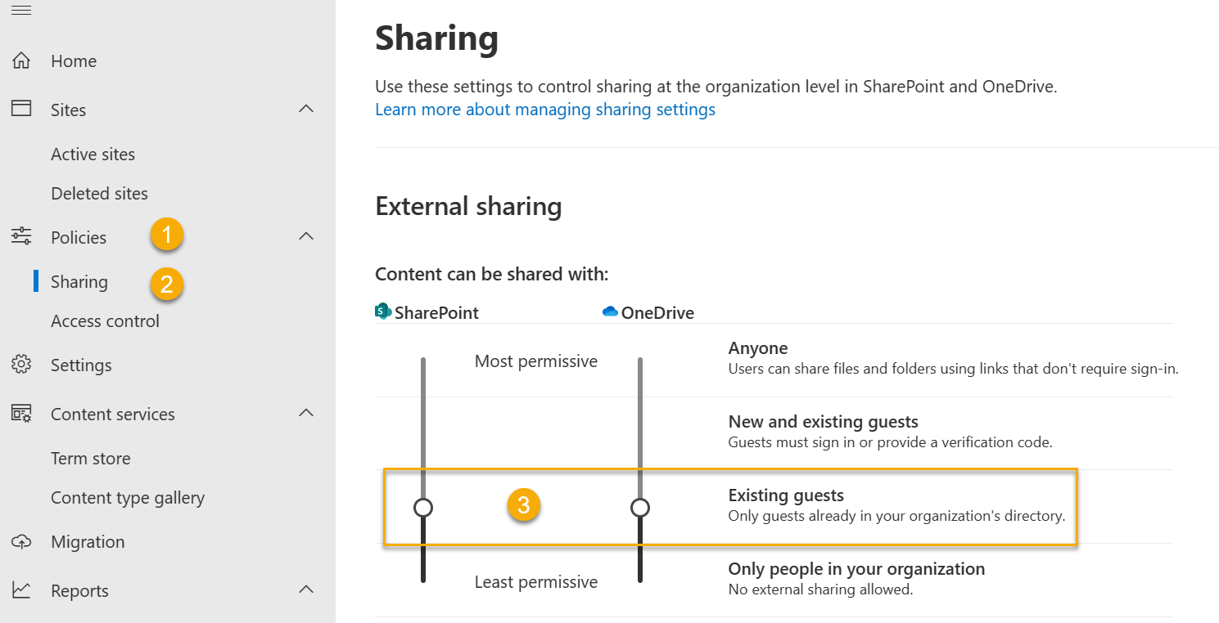
To only allow external sharing for OneDrive/SharePoint Online with Azure AD B2B collaboration, Admin needs to set the sharing option to “Existing guest”.
After enabling external sharing, the ability to search for existing guest users in the SharePoint Online (SPO) people picker is OFF by default to match legacy behavior.
Use the setting 'ShowPeoplePickerSuggestionsForGuestUsers' at the tenant and site collection level to re-enable ability to search for guest users in SPO people picker

Slide 30
Best Practices

Slide 31

External Sharing Best Practices
If you invite external users to your Team site, they will be able to view the content on the Team site and all subsites
Use a flat site structure which is a site collection that contains only the root level site and no sub sites. This will help prevent unintended access to content stored within a site collection
By default, it is possible for invitation recipients to share anonymous guest links with others, who could use them to view content.
Admin can change the setting
Do not use anonymous guest links to share documents that are sensitive
If you need to minimize the risk that someone might share an anonymous link, share a document by requiring sign-in instead
Notes:
How to Share Without Oversharing
Best Practices for Sharing Sites
If you have shared an entire site with a user, then that user will be able to sign in to the site and function like a full member of the site. The user will be able to browse, search for, view, and edit content (depending on which permission group you assign the user to). They will be able to do things like: see the names of other site users in the People Picker or view document metadata. External users will also appear in the People Picker as site users. This means that other people who use your site could grant different permissions to these users than you initially granted when you shared the site with them. Ensure that you know the identity of external users before you invite them to your site.
If you invite external users to your team site, they will be able to view content on the team site and all subsites. If you want to avoid having external users gain access to important or sensitive content on your team site, then you should create a subsite of your team site that has unique permissions, and then share only that subsite with external users.
For more information about permissions inheritance, see What is permissions inheritance? (http://office.microsoft.com/client/15/help/preview?AssetId=HA102772762&lcid=1033&NS=SPOAdmin&Version=15&CTT=5&origin=HA102894713)
Similarly, if you want to share a sub-site that you have created on your OneDrive for Business location, you might want to ensure that it has unique permissions, so that you do not accidentally grant users permission to additional sites or content on your OneDrive for Business site.
Best Practices for Sharing Documents
If you share documents by using anonymous guest links, then it is possible for invitation recipients to share those guest links with others, who could use them to view content. Do not use guest links to share documents that are sensitive. If you want to minimize the risk that someone might share an anonymous link, then share a document by requiring sign-in instead.

Slide 32
External Sharing Best Practices
Even if your organization-level setting allows external sharing, not all new sites allow it by default.
The default sharing setting for Microsoft 365 group-connected team sites is "New and existing guests."
The default for communication sites and classic sites is "Only people in your organization.“
In some cases, the sharing setting will need to be adjusted at the site collection level in order to provide the level of external user access that’s needed.
I.E. As mentioned before with site scripting
The sharing setting defined at a site collection cannot be more permissive than what’s defined in the SPO admin center at the tenant level.

Slide 33
Demonstration
Enabling External Sharing
Tenant level
Site Collection level
Document level
Notes:
In SharePoint Admin Center ->Sharing, show the students where External Sharing is set to Allow both external users who accept sharing invitations and anonymous quest links.
In SharePoint Admin Center/site collections, highlight the default team site for your tenant and click the Sharing button, and verify that Allow both external users who accept sharing invitations and anonymous quest links option is already set.
Send sharing invitation from a site.
Send sharing invitation from a document.

Slide 34
Knowledge Check
If you select the option to share with only those who sign in as authenticated users, what are the ways the external user can gain access?
Can One Time Passcode authentication be used at the site level?
Where do you configured the domains Allowed or Blocked list for Microsoft 365 Groups ?
A Microsoft Account (Live ID) or login from another tenant
No. The one-time passcode authentication is only used when sharing files or folders with users that do not have a Microsoft account or an Microsoft 365 account in another tenant
The domains Allowed or Blocked list for Microsoft 365 Groups is configured in Azure Active Directory portal under User Settings/ Manage external collaboration settings
Notes:
If you select the option to share with only those who sign in as authenticated users, what are the ways the external user can gain access?
Answer: A Microsoft Account or sign in from another tenant.
By default, do subsites inherit site collection-level permissions?
Answer: Yes. By default, subsites inherit permissions from site collection.
Is it considered best practice to place individual user accounts in the SharePoint access control lists?
Answer: No. It is recommended that security groups and/or Active Directory groups are used in SharePoint groups when possible.

Slide 35
Summary
In this lesson, you learned how to:
Configure external sharing at the tenant and site collection levels
The different types of external users
Enabling external user access
Governing external user access

Slide 36
Lab M7
Exercise 1 - External Sharing administration

